Slide 1



Syntactic, Semantic and Sentiment Analysis : The Joint Effect on Automated Essay Evaluation
Alvi Anowar
ID: 23366031
CSE - 713

Slide 2
INTRODUCTION
Manual Essay Evaluation
Time-consuming and variable manual grading.
Automated Grading Benefits
Utilizes rule-based grammar
Consistency tests, and semantic similarity algorithms.

Slide 3

RELATED WORK
Project Grade Essay R : Early AES using statistical methods and linear regression.
Intelligent Essay Assessor : Integration of NLP, LSA, and ML.
Intellimetric R: Introduction of NLP and mathematical models.
E-rater R : NLP-based scoring and feedback.

Slide 4
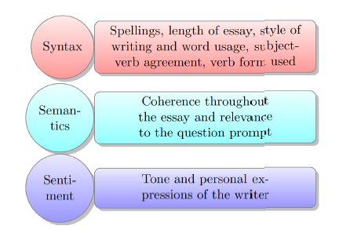
Methodology
Syntactic Attributes: Focused on word order using various syntax-related features.
Semantic Attributes: Measured coherence and semantic similarity using word embeddings.
Graph-based Features: Derived from semantic similarity, with relevant connections selected.
Sentiment Analysis: Implemented using a rule-based model.

Slide 5
Dataset and Preprocessing
ASAP competition dataset.
System evaluation using the QWK metric.
Feature was selected through univariate selection and recursive feature selection.
23 Salient high predictive power
Graph-based feature threshold 0.4

Slide 6
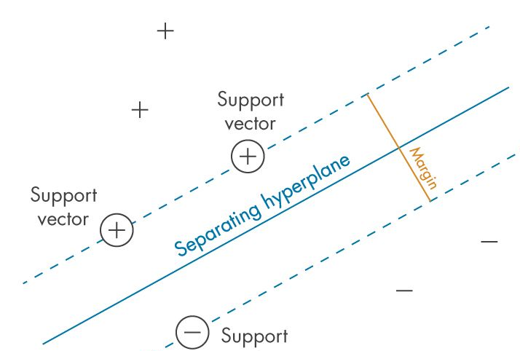
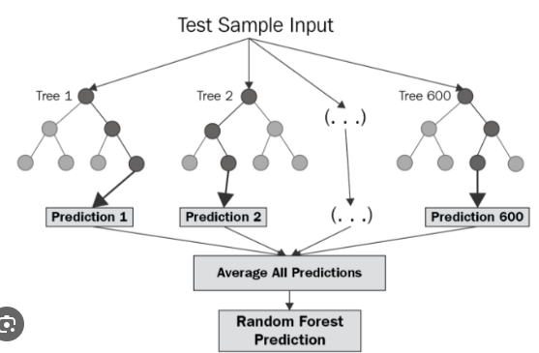

Models
Support Vector Machine
2. Random Forest
Regressor
3. Three-layer Neural Network

Slide 7
Conclusion
Best Performance
Three-Layer Neural Network
Outperformed other automated scoring systems.
Average QWK of 0.793.
Slightly lower performance than one system (SBLSTMA)
Future Research Directions
Explore LSTM for sequential data analysis.
Study the information flow between consecutive sentences.

Slide 8



THANKS!

